Slide 1
Gulp Setup

Slide 2
Are you doing these by hand?
running a local dev server
minifying/uglifying code
optimizing images
preprocessing CSS
etc.
Notes:
These are the kinds of manual tasks that Gulp or other build systems can be configured to do automatically.

Slide 3
Example: Uglify JS
var gulp = require('gulp'); var uglify = require('gulp-uglify');
gulp.task('uglify-js', function() { gulp.src('src/js/*.js') .pipe(uglify()) .pipe(gulp.dest('dist/js')); });
gulpfile.js
Notes:
In this example, a gulpfile.js file is shown. This is the file where gulp tasks are defined.
gulp and gulp-uglify plugins are included.
An uglify-js task is defined.
This task reads all the .js files from src/js/ and pipes them to an uglify function (imported from the gulp-uglify plugin), which uglifies them. The uglified files are then piped to gulp.dest, which writes the new files to dist/js/.

Slide 4
Gulp automates tasks
Gulp tasks
source files → plugin(s) → production files
Notes:
Gulp is a cross-platform, streaming task runner that lets developers automate many development tasks. At a high level, gulp reads files as streams and pipes the streams to different tasks. These tasks are code-based and use plugins. The tasks modify the files, building source files into production files. To get an idea of what gulp can do check the list of gulp recipes on GitHub.

Slide 5
Setting up gulp
Install Node and npm (once)
Install Gulp CLI (once)
Create project & install plugins
Write tasks in gulpfile.js
Run tasks from the CL
Notes:
Gulp is a Node package, and the plugins that it uses are also Node packages. To use gulp, Node and the Node Package Manager (npm) must be installed.
To use Gulp from the command line, gulp's command line interface needs to be installed too. Once you have npm, you can do this with: npm install --global gulp-cli
Once these global tools are installed, gulp and its plugins can be installed in a project. These are all similarly installed via npm on the CL.
With all the packages in your project, you can create tasks in a gulpfile.js file. This is a JS file that gulp will read to perform actions.
The corresponding tasks can be executed from the CL.

Slide 6
Create project & install plugins
# Command line npm init
npm install gulp --save-dev npm install pluginA --save-dev npm install pluginB --save-dev npm install pluginC --save-dev
command line
Notes:
The first line here creates a new Node project. This generates a package.json file in your project that can be used to easily track your project's plugins.
The following commands install various example plugins (including gulp itself). The --save-dev flag updates the package.json file with the corresponding plugin. The plugins are installed in a node_modules directory.
With this method, you can easily reinstall all plugins and their dependencies later by using the package.json file, rather that reinstalling each plugin individually.

Slide 7
Write tasks in gulpfile.js
// include plugins var gulp = require('gulp'); var pluginA = require('pluginA'); var pluginB = require('pluginB'); var pluginC = require('pluginC');
gulpfile.js
Notes:
Once the plugins are installed, they need to be required in the gulpfile.js configuration file. This is the file where gulp tasks are defined.

Slide 8
Write tasks in gulpfile.js (cont.)
// define task(s) gulp.task('task-ABC', function() { gulp.src('some-source-files') .pipe(pluginA()) .pipe(pluginB()) .pipe(pluginC()) .pipe(gulp.dest('some-destination')); });
gulpfile.js
Notes:
In the same gulpfile.js file, we define a task (multiple can be defined). This task is named task-ABC. It takes files from the some-source-files path, and pipes them through functions from each of the plugins (which modify the files). The processed files are passed to gulp.dest, which writes the files to the some-destination path.

Slide 9
Run tasks from the CL
# Command line gulp task-ABC
command line
Notes:
The task we just defined in the gulpfile.js file can be executed by running this command from the CL (gulp + task name).

Slide 10
Resources
Resources
Gulp's Getting Started
List of gulp Recipes
FAQ
Gulp Plugin Registry

Slide 11
Extra Credit

Slide 12
Default tasks
// gulpfile.js - set default tasks gulp.task('default', ['task1', 'task2', 'task3']); # Command line gulp
Notes:
Default tasks run when the gulp CL command is run without a task specified.
This code assigns task1, task2, and task3 to be run when gulp is executed from the CL.
This is useful for running a collection of common build tasks at once.

Slide 13
gulp.watch
// gulpfile.js - set watch gulp.task('watch', function() { gulp.watch('styles/**/*.css', ['processCSS']); gulp.watch('js/**/*.js', ['processJS']); }); # Command line gulp watch
Notes:
gulp.watch allows files to be monitored for changes. When the files change, tasks can be run automatically.
This code sets watches on all CSS files in the styles directory, and all JS files in the js directory. If any CSS files change, the processCSS task is automatically run. If any JS file changes, the processJS task is automatically run.
The watch task is started by running gulp watch from the CL (though this task can be named anything).

Slide 14
Slide parking lot

Slide 15
Agenda
Introduction
Setting up your project
Making Gulp do things

Slide 16
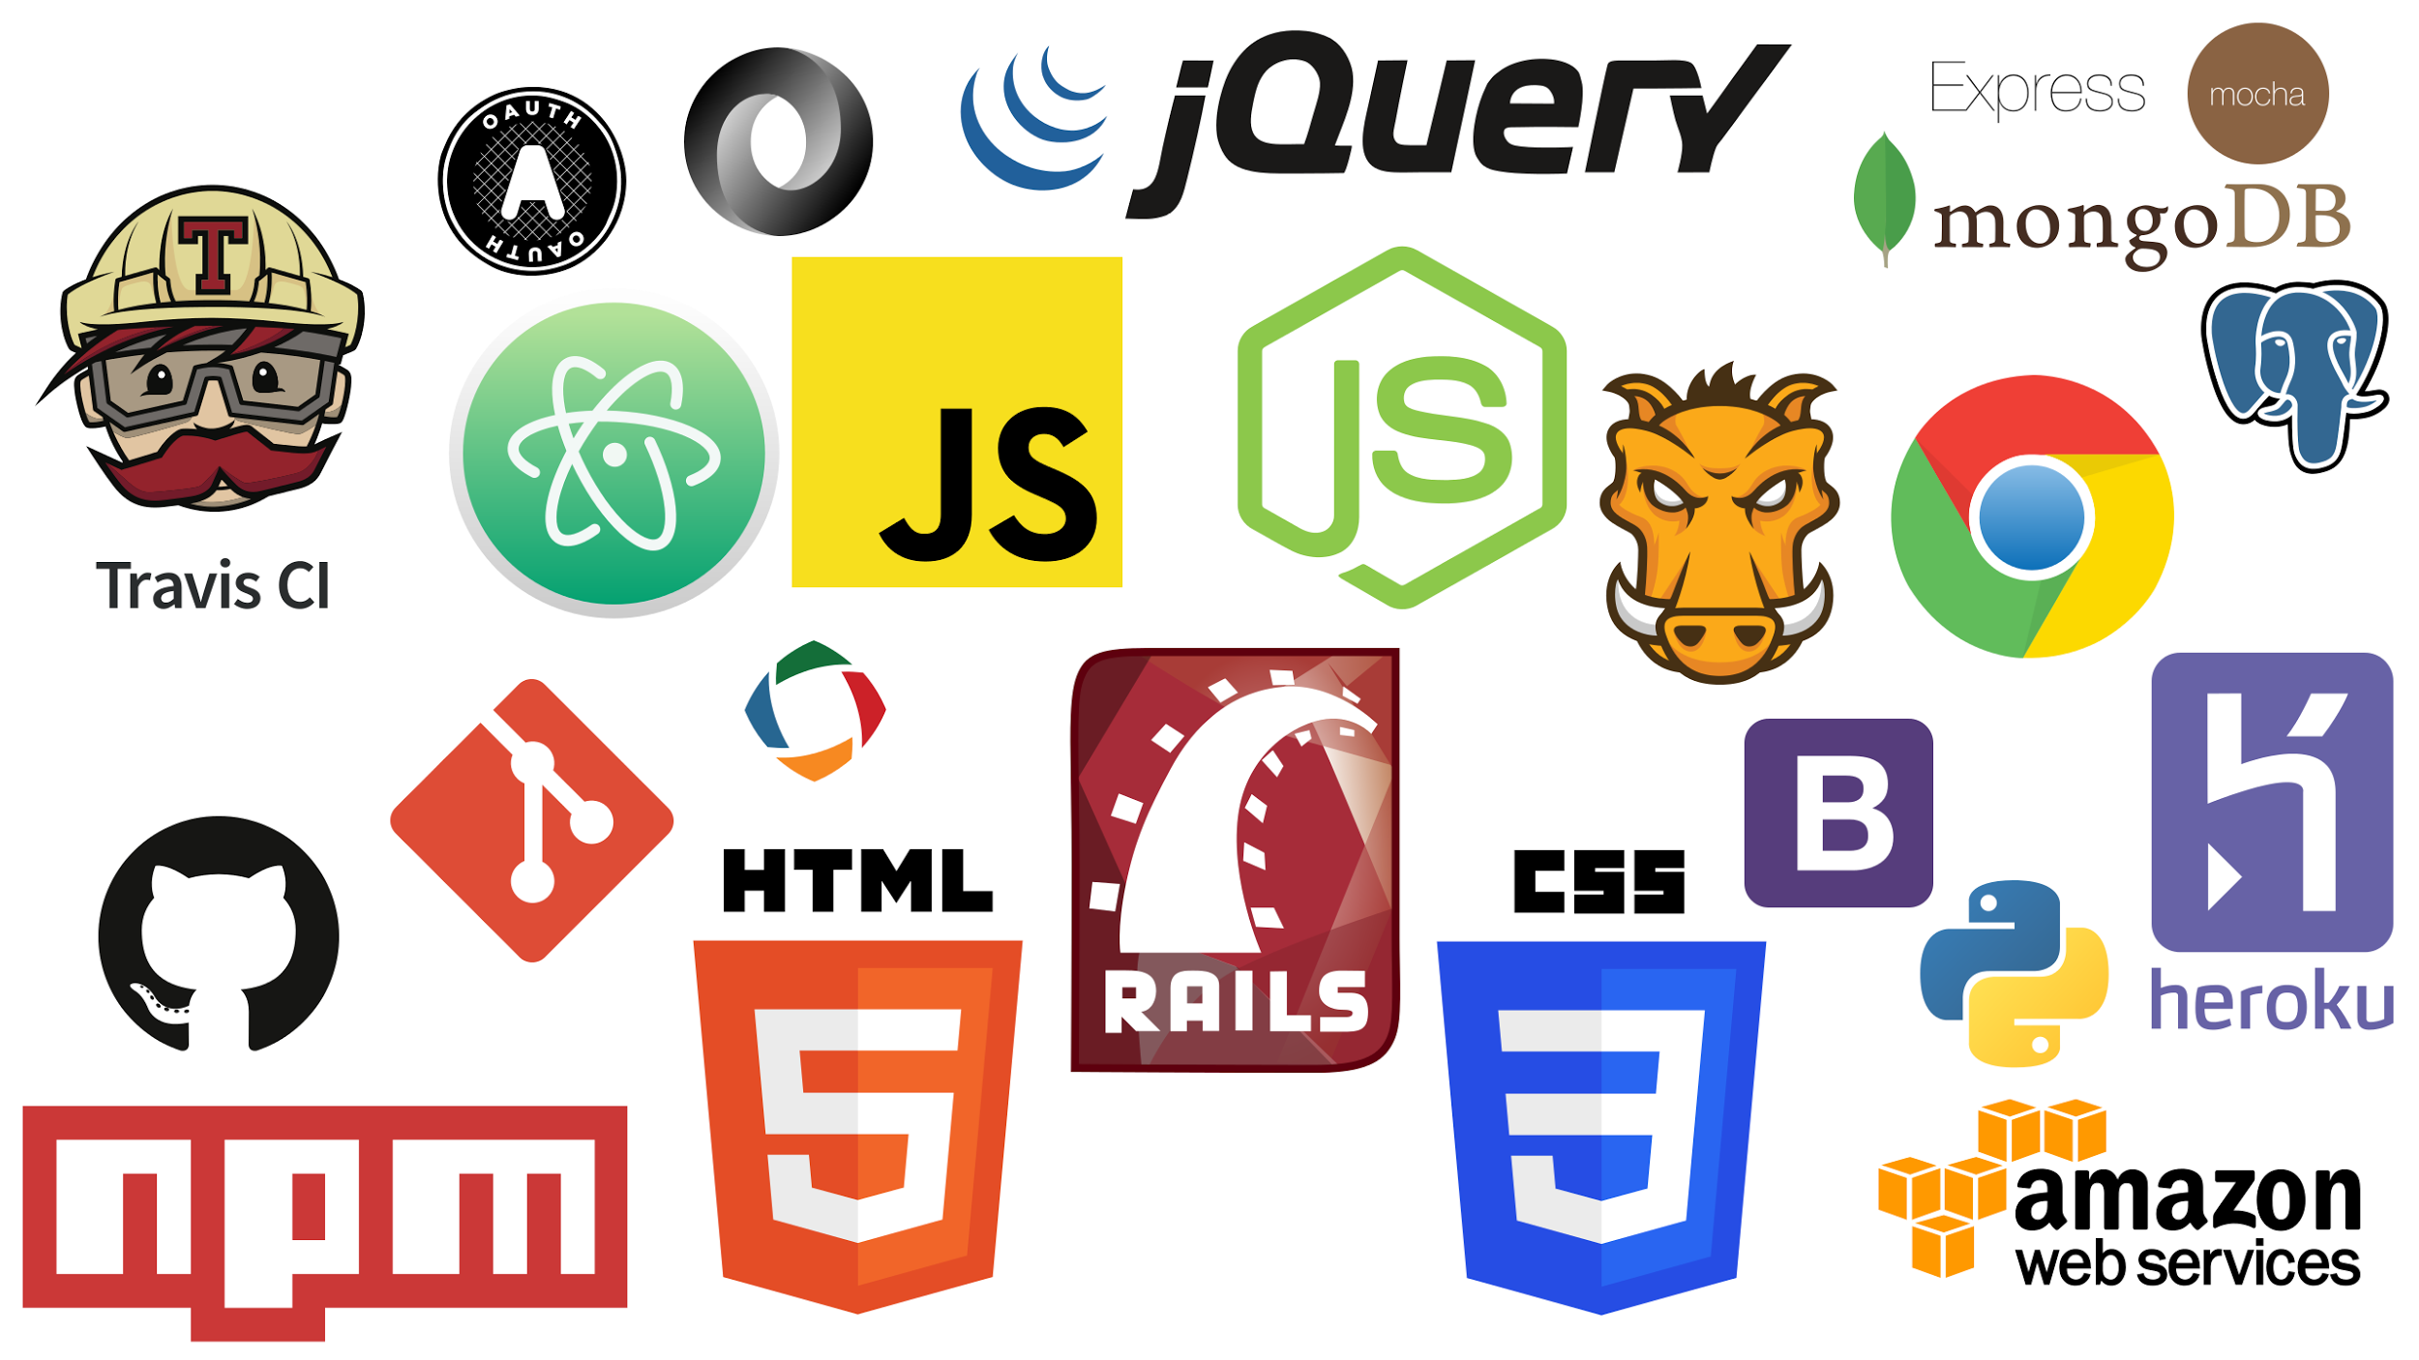
Introduction
Credit: http://imgur.com/gallery/DZTBGB6
Notes:
There are many choices to make when working in new web applications.
From task runners and build systems to databases to backend systems, to authoring tools and hosting providers, to JS and CSS frameworks.
Rather than try to cover every system available we’ll concentrate on Gulp as our task runner and leave other tooling choices to your team and applications.

Slide 17

Introduction
Credit: Gulpjs.com (MIT)
Notes:
Why Gulp?
Gulp is a streaming task runner. It will allow you to automate most repetitive tasks on your build, testing and deployment processes. You don’t have to worry about copying files, compiling your SASS to CSS or your Coffeescript to Javascript that runs on the browser. With Gulp you can configure your tasks once and then run them as needed.
Gulp has seen the biggest recent adoption and it enjoys a healthy plugin ecosystem.
It is by no means the only build system or task runner available. If you have your preferred system it should not be difficult to adapt these

Slide 18
Installing Gulo
Installing Gulp globally
npm install -g gulp-cli
Requiring Gulp in your project
npm install gulp --save-dev
Notes:
Installing Gulp is a two step process.
While in the project’s root directory
Install gulp-cli globally. Gulp-cli is a wrapper around a project’s local Gulp installation and it makes it easier to work with since you don’t have to type the full path to the project’s Gulp instance every time you want to use it.
The second step is to install Gulp into your project. We use `--save-dev` to tell NPM that it should store a reference to gulp in the package.json configuration file under the development dependencies.

Slide 19
Making Gulp do things
var gulp = require('gulp'); var paths = {src: 'app/'}; gulp.task('task-name', function() { return gulp.src('source-files') .pipe(aGulpPlugin()) .pipe(gulp.dest('destination')); });
Notes:
Gulp stores all the configuration and tasks for the project in a configuration file, gulpfile.js.
The structure of the gulpfile is not set in stone but this is what appears in most examples:
In the first section we `require` the plugins we will use and assign them to variables. This tells Gulp what plugins we want to use and it makes the available to our code at the same time.
The second block contains any variables that we’ll use in our tasks.
The last section contains one or more tasks that will actually accomplish our goals. In this case it’s a generic task to demonstrate the structure of the gulpfile.

Slide 20
Making Gulp do things
gulp.task(name, anon-function…)
gulp.src → .pipe(plugin)⁺ → gulp.dest
gulp.watch
Notes:
IN addition to plugins, Gulp exposes the following methods as its API:
gulp.task: used to define a task for Gulp to run
gulp.src: provides a list matching the glob parameter that will be acted upon
gulp.dest: destination of a task. Re-emits all data passed to it so you continue the pipe for your task. Folders that don't exist will be created.
gulp.watch: watches a given file or folder and performs the indicated task when its target changes.
It may sound hard to believe that it’s just these four tasks what make Gulp run successfully. We’ll see how it works in the next slides.

Slide 21
Example: Copying files in Gulp
gulp.task('copy-content', function() { gulp.src('app/**/*.{html,css,jpg,png,gif,svg}') .pipe(gulp.dest('./dist')); });
Notes:
In this example we can see the structure of a Gulp task.
We define the task with two parameters a task name and an anonymous function that holds the actual code to process the task.
Inside the anonymous function the first step is to return the source for the task, a glob or list for all the files that this task will work upon.
We then pipe this list of files to one or more plugins with the last being a call to gulp.dest to tell it where to put the resulting file or files. Pipe is not part of Gulp but a method in the Node.js API

Slide 22
Example: Transpiling CSS in Gulp
gulp.task('processCSS', function() { return gulp.src('./css/**/*.css') .pipe(sourcemaps.init()) .pipe(autoprefixer()) .pipe(sourcemaps.write()) .pipe(gulp.dest('./css')); });
Notes:
This example uses multiple plugins to produce prefixed CSS output. It also shows how to pass parameters to a plugin.

Slide 23
Example: Page Speed Insights in Gulp
gulp.task('psi:mobile', function() { var site = 'CHANGE_TO_YOUR_SITE'; return psi(site, { nokey: 'true', strategy: 'mobile', format: 'cli' }).then(function(data) { console.log('Speed score: ' + data.ruleGroups.SPEED.score); }); });

Slide 24
Lab: Gulp
Install Node w/ NPM (if needed)
Install Gulp (if needed)
npm install -g gulp-cli
Get the lab project
Grab NPM dependencies
for (_ in 1..3) { Add a Gulp task, run }

Slide 25
Setting up your project
Directory Structure
$ mkdir my-project
$ cd my-project
$ mkdir img
$ mkdir js
$ mkdir css
Notes:
This presentation assumes that you’re starting a new project
Before starting to work with Gulp we need to set up its structure and decide how we want to organize the files.
Create your project directory
$ mkdir my-project
Change to the directory you just created
$ cd my-project
Once inside `my-project` make directories for images, Javascript and CSS. Make sure that you run
$ mkdir img
$ mkdir js
$ mkdir css
With these commands we’ve created the directory structure for my-app. If need to create additional directories you can follow the same process. Make sure there are no spaces in the directory names.

Slide 26
Setting up your project
$ npm init
Notes:
Before we can install Gulp and other plugins we need to initialize our application as a Node.js application. We do this by running:
$ npm init
In our project directory.
This command starts the NPM initialization. You will be asked a series of questions, shown below. It’s ok to leave everything blank for now; we can go back and edit it later. When you’re done answering these questions NPM will use your answers to generate a `package.json` file. Later we’ll use this file to store informations about the plugins we want to work with.

Slide 27
Examples of Gulp Tasks
gulp.task('generate-service-worker', (callback) => {
swPrecache.write(path.join(paths.src, 'sw.js'), {
staticFileGlobs: [
paths.src + 'index.html',
paths.src + 'js/main.js',
paths.src + 'css/main.css',
],
importScripts: [
'./js/sw-toolbox.js',
'./js/toolbox-scripts.js'
],
stripPrefix: paths.src
}, callback);
});
Notes:
This example uses sw-precache, sw-toolbox and a custom script that uses sw-toolbox (toolbox-scripts) to programmatically build a service worker. This worker will cache the files under staticFileGlobs and import sw-toolbox and toolbox-scripts which will, in turn, do dynamic caching for our application.

Slide 28
Setting up your project
If you’ve already started your project
$ npm init
$ npm i -g gulp-cli
$ npm i gulp --save-dev
Notes:
If you’ve already decided on your project’s directory structure the process of getting started with Gulp is simpler.
Run `npm init` to initialize your `package.json` file. If you’ve done this before you will get the existing values in parenthesis and will be able to change them at this time.
If you haven’t done so you you can instal Gulp globally and as part of your project’s developer dependencies.

